Slide 1
STANDARDIZATION OF RNA ANALYSES IN CLINICAL TISSUES
34th European Congress of Pathology
Serena Bonin
Basel, 7th SEPTEMBER 2022

Slide 2


Slide 3
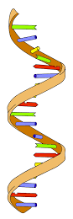
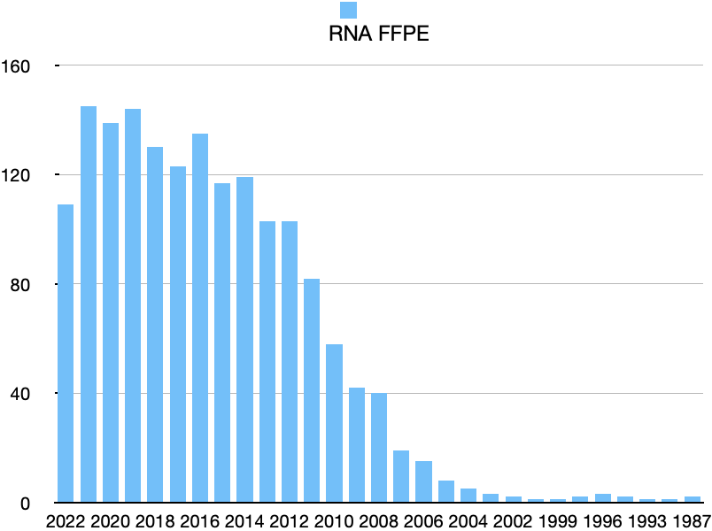
RNA analyses from FFPE
1987-1999: 12 articles
2000-2011: 287 articles
2012-2022: 1224 articles

Slide 4
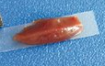
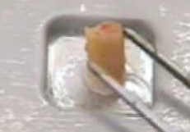
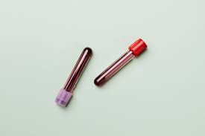
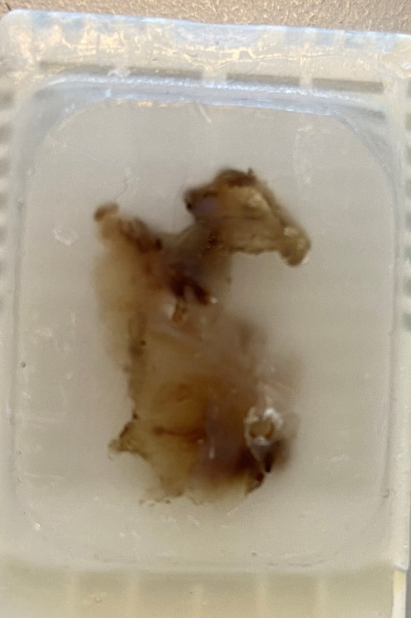
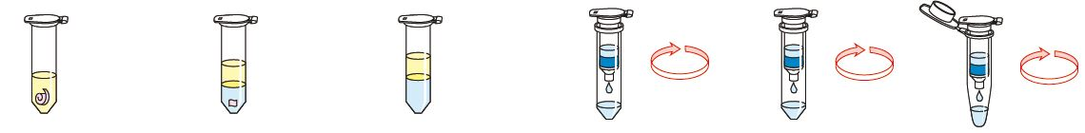
RNA isolation from clinical tissues
≠ yield
≠ quantity
≠ quality
Paraffin Sample RNA RNA RNA RNA
Removal digestion/lysis demodification binding washing elution

Slide 5
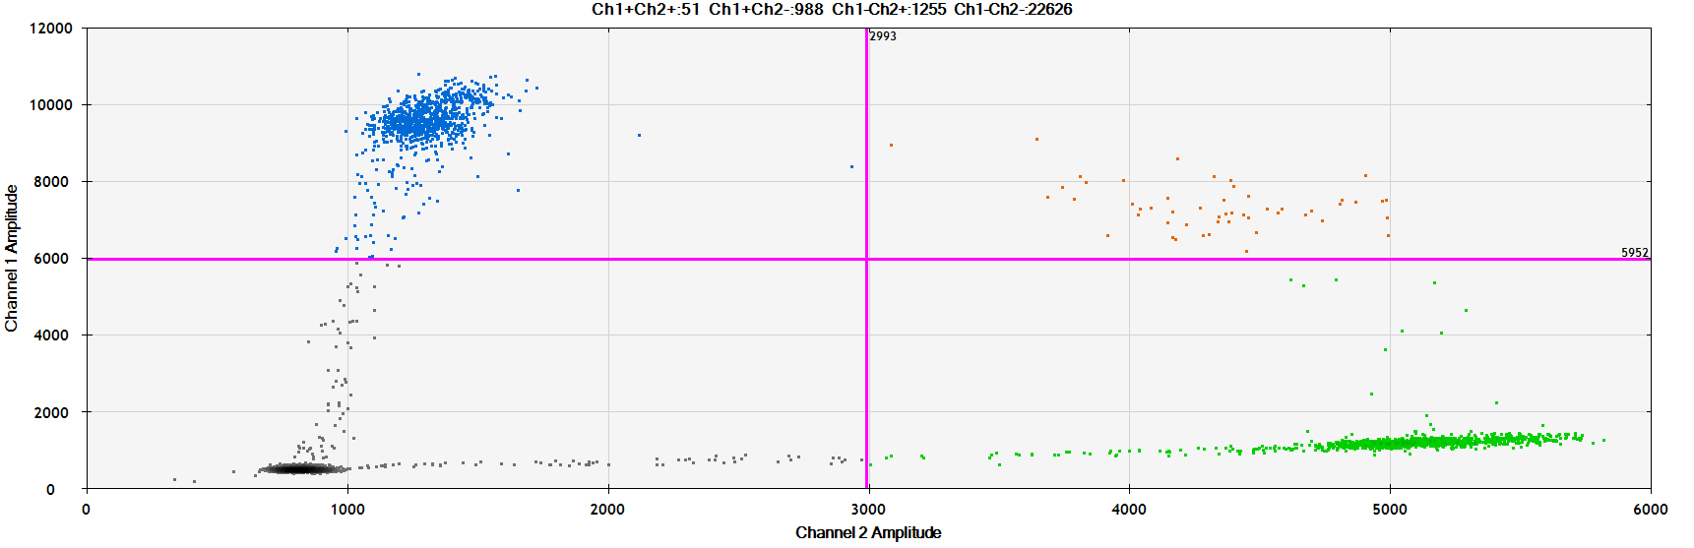
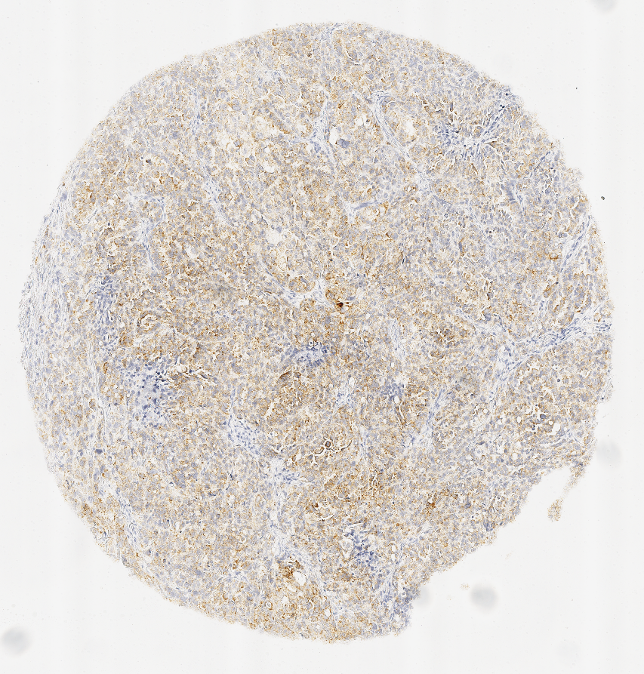
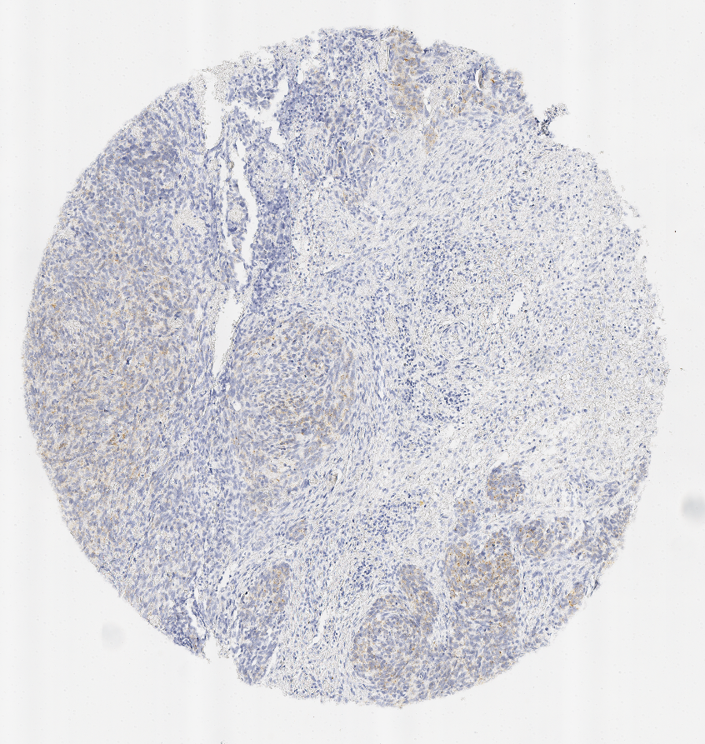
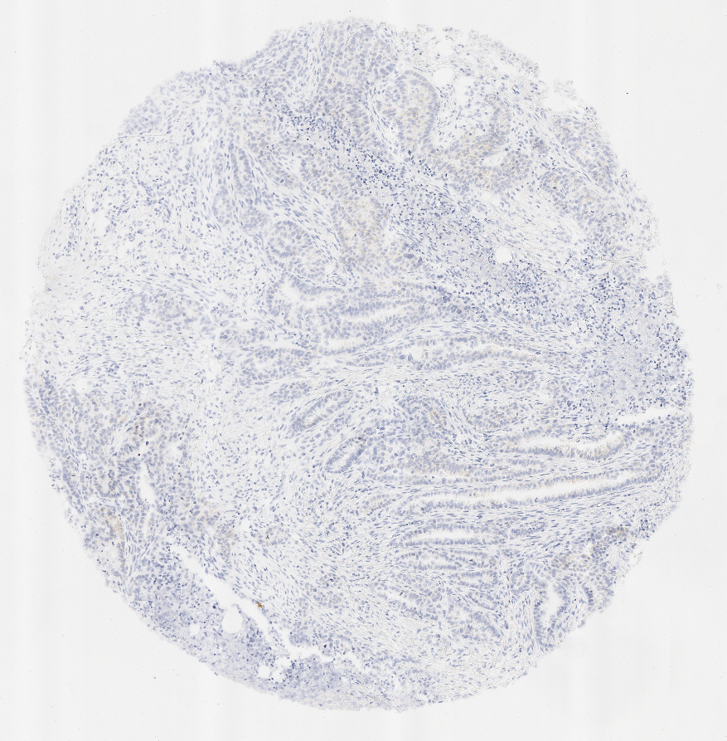
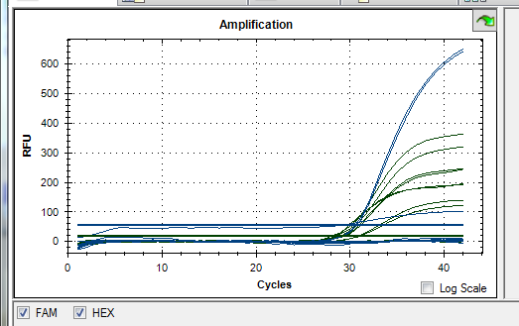
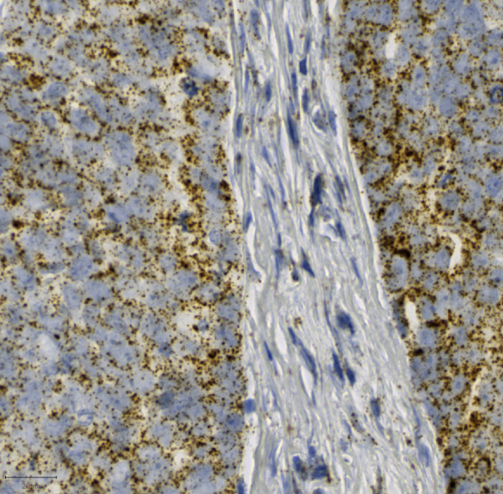
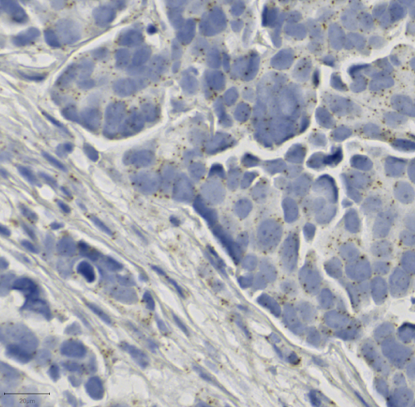
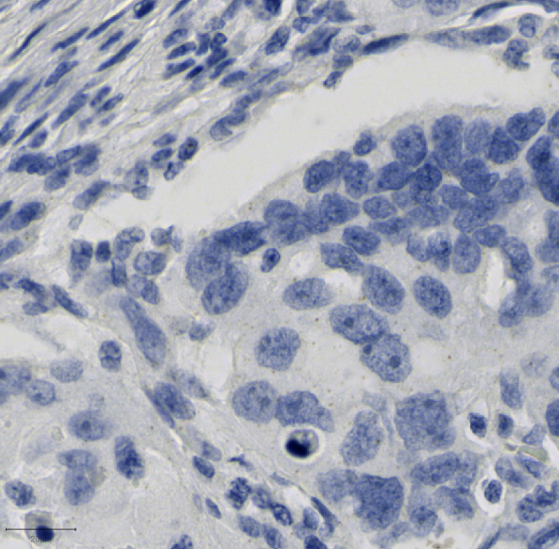
SINGLEPLEXING/MULTIPLEXING

Slide 6
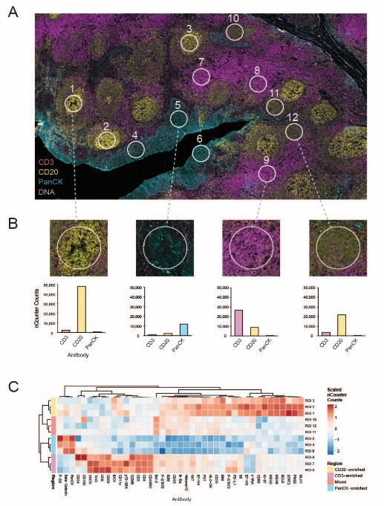
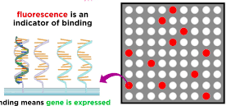
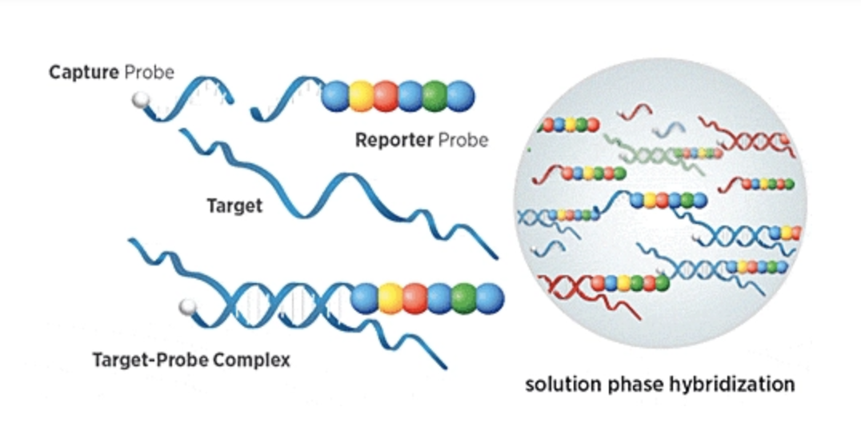
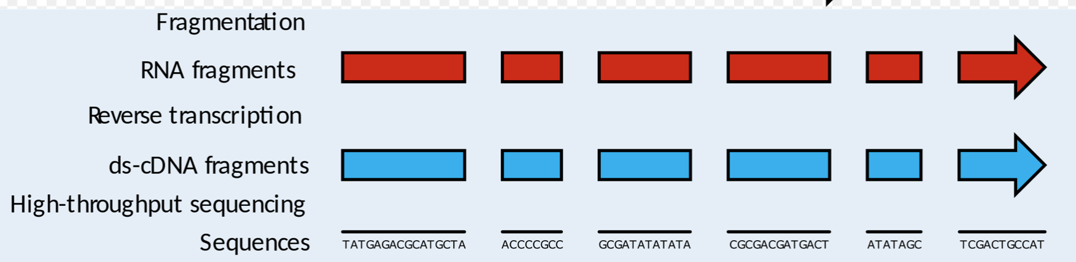
HIGH THROUGHPUT
Courtesy DIATECH

Slide 7
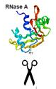

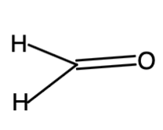
Enzymatic
Chemical
RNA Degradation
Physical
OH-
Any step of the RNA analyses can influence the diagnosis or research results

Slide 8

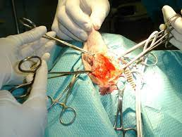
THE PRE-ANALYTICAL PHASE
LIQUID TISSUES
SOLID TISSUES

Slide 9
USE OF ISO STANDARDS AND CEN TECHNICAL DOCUMENTS
CEN/TS 17688-1:2021-Molecular in vitro diagnostic examinations - Specifications for pre-examination processes for Fine Needle Aspirates (FNAs) - Part 1: Isolated cellular RNA
CEN/TS 17390-1:2020-05-Molecular in vitro diagnostic examinations - Specifications for pre-examination processes for circulating tumor cells (CTCs) in venous whole blood - Part 1: Isolated RNA

Slide 10
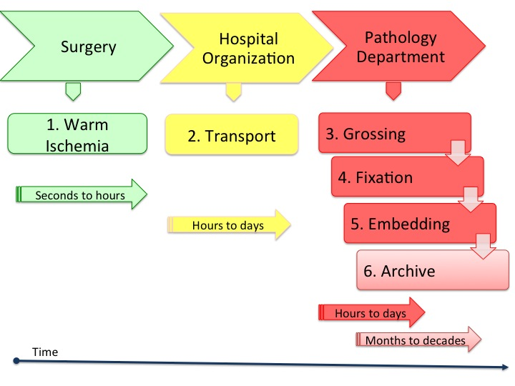
TISSUE PREANALYTICS
SNAP FROZEN + FFPE

Slide 11
Outside the pathology lab Inside the pathology lab
Surgery
Hospital Organization
Pathology Department
1. Warm Ischemia
2. Transport
3. Grossing
4. Fixation
5. Embedding
6. Archive
Seconds to hours
Hours to days
Warm ischemia: the time between ligation of arteries and removal of tissues (hypoxia at 37°C) depends on:
a) Type of operation
b) Modality of intervention
c) Ability of the surgeon
From half to 1 hour (stomach, lung, colon, ……..)
Hours to days
Months to decades

Slide 12
Outside the pathology lab Inside the pathology lab
Surgery
Hospital Organization
Pathology Department
1. Warm Ischemia
2. Transport
3. Grossing
4. Fixation
5. Embedding
6. Archive
Seconds to hours
Hours to days
Interval from the surgical table to the pathology lab
Alternatives to shorten cold ischemia:
a) Tissues left fresh transported at r.t. or in wet ice*
b) Tissues immersed in formalin-small biopsies-annotation time
c) Transport at 4°C under vacuum
Hours to days
Months to decades

Slide 13
WARM AND CALD ISCHEMIA
# Inducible genes: warm ischemia and cold ischemia can differently influence genes with increased or decreased expression, with changes in mRNA expression but also at the protein level.
# On the other hand, many genes can be totally indifferent to ischemia.
Outside the laboratory:
Annotation of warm ischemia time: date and time of tissue removal and method of removal
Cold ischemia- transport in wet ice or Under Vacuum-fresh frozen
- Preferable formalin-free for FFPE
Journal of Surgical Research 99, 222–227 (2001)
Importance of freezing tissue within 20 min.

Slide 14
WARM AND COLD ISCHEMIA
# miRNA profiles vary during warm and cold blood STH2 cardioplegia during prolonged on-pump and off-pump
Diagnostics 2020, 10, 240; doi:10.3390/diagnostics10040240
# miRNA can alter their profile during cold ischemia time

Slide 15
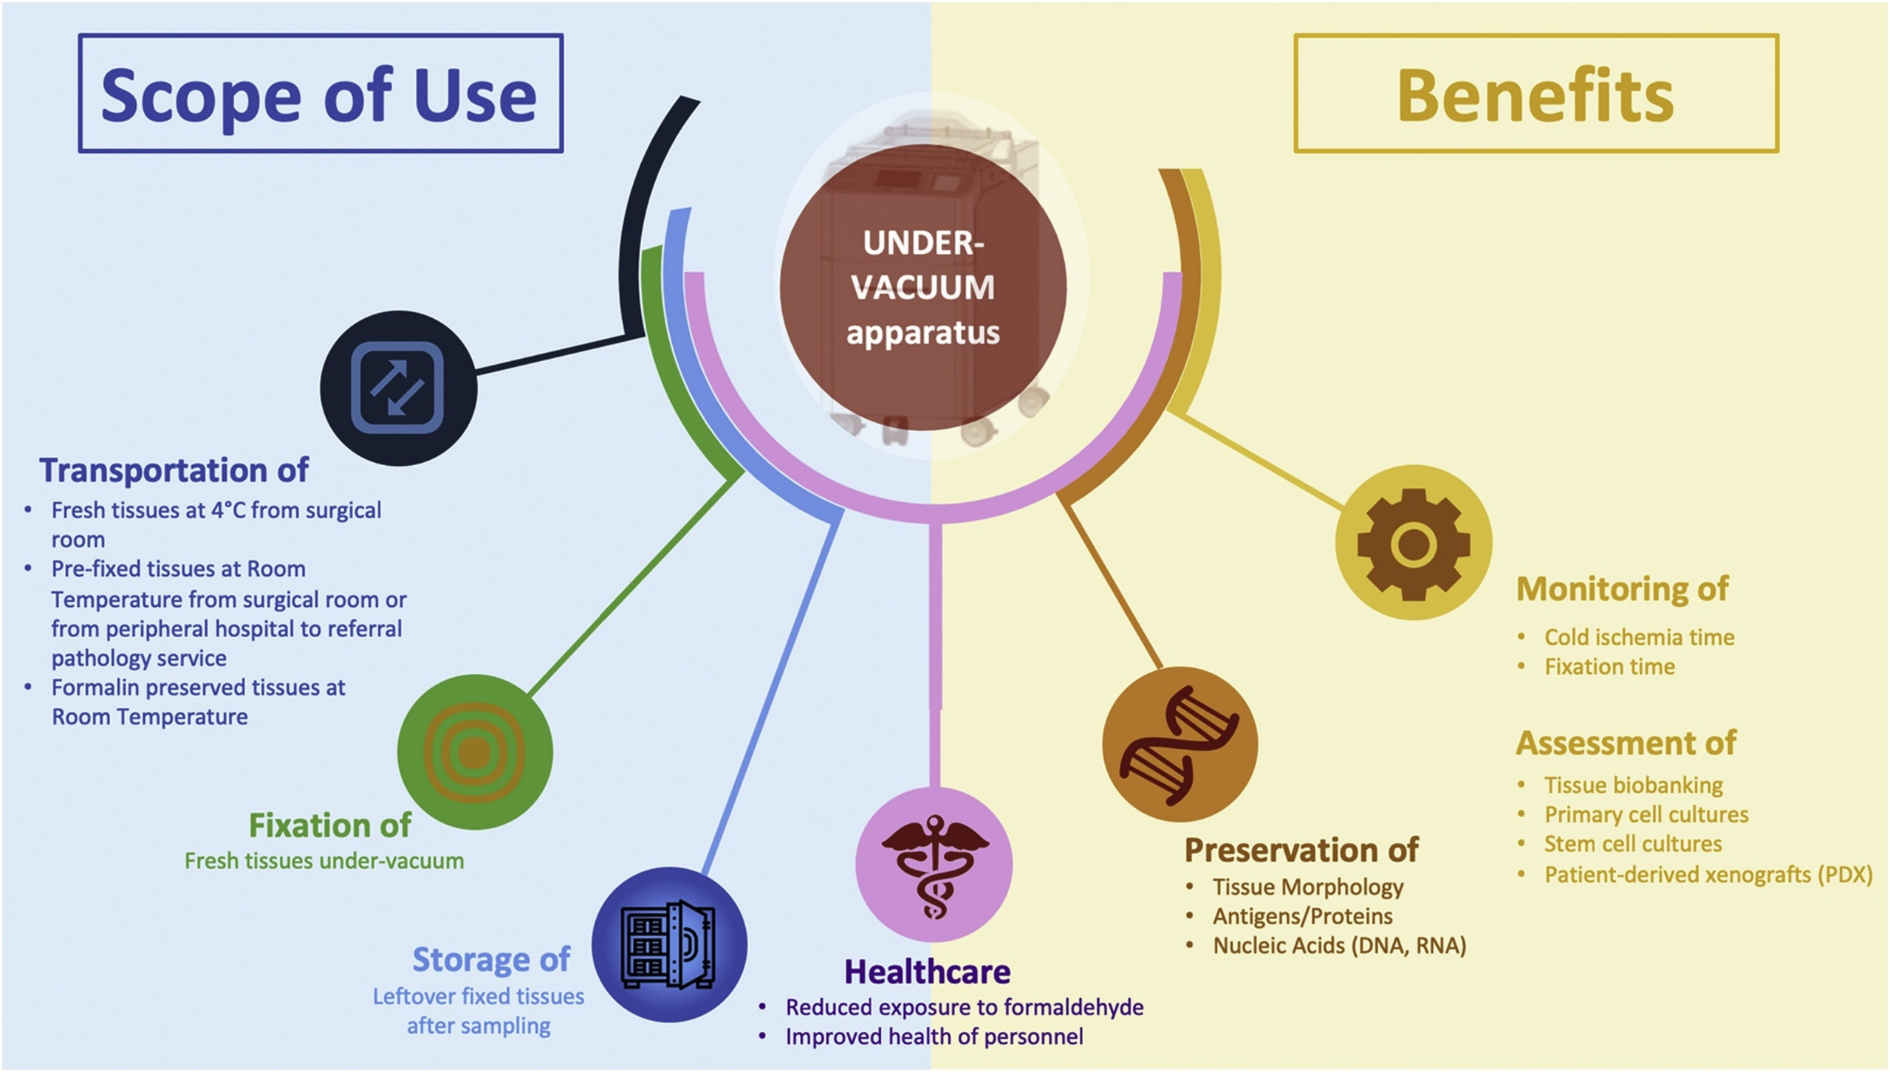
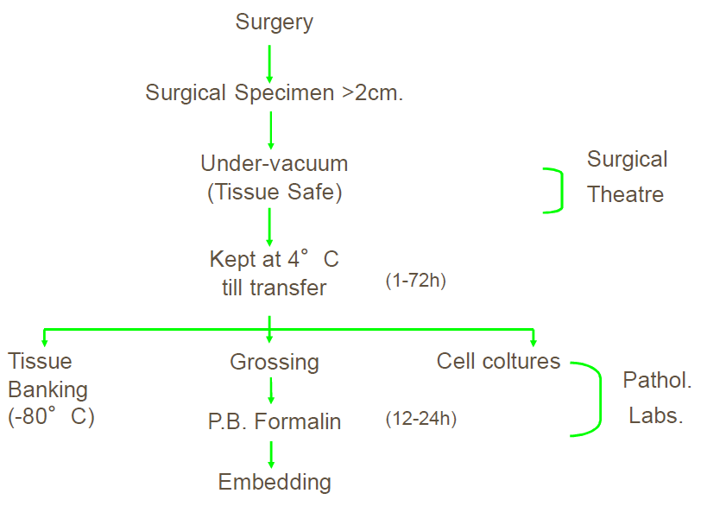
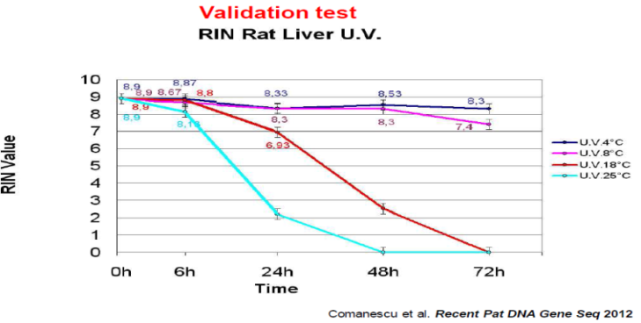
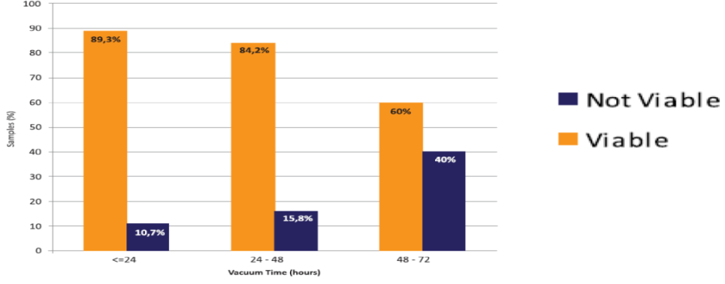
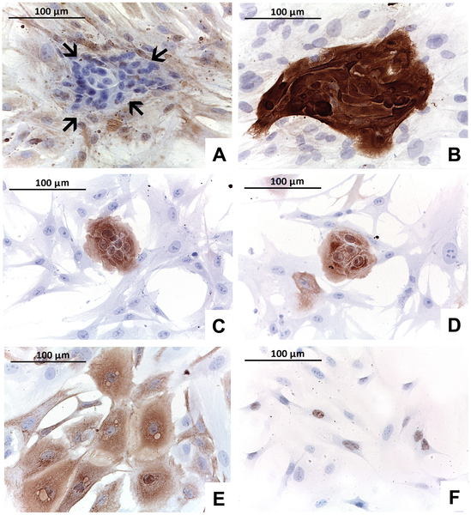
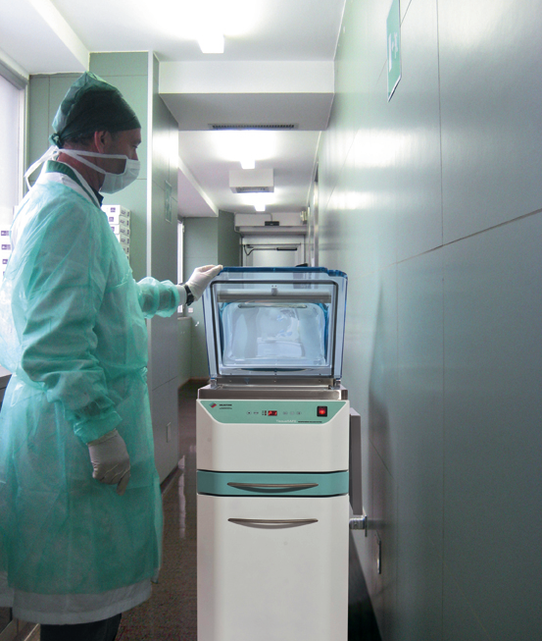
WARM AND CALD ISCHEMIA
Tissue transport under vacuum
Bussolati-2014
New Biotechnology 2019, 52:104-109
G. Bussolati Graz 2014
Cell Cultures
(2013) A Collection of Primary Tissue Cultures of Tumors from Vacuum Packed and Cooled Surgical Specimens: A Feasibility Study. PLOS ONE 8(9): e75193.

Slide 16
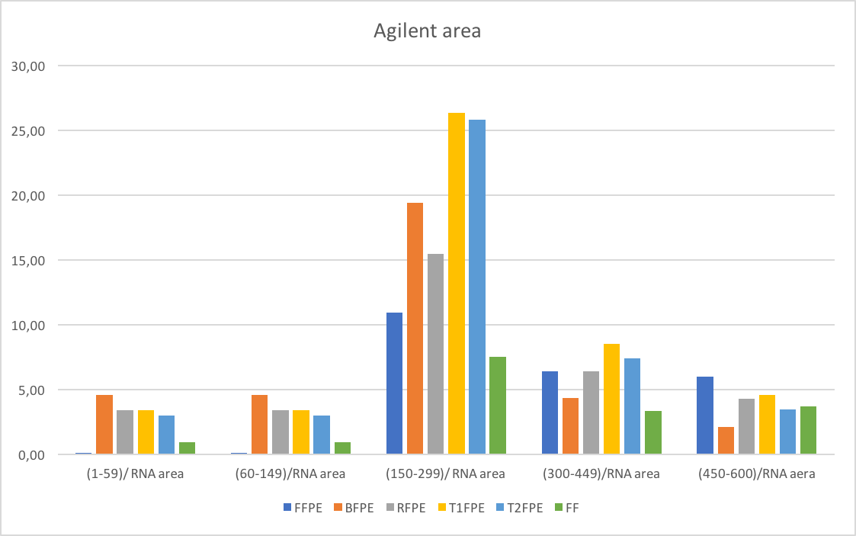
Stringent standard procedures guarantee Higher RNA quality in FFPE tissues
# Inside the laboratory
Grossing
Freezing
Fixation time
Validated extraction procedures
N Biotechnol 2022 Jul 22;71:30-36

Slide 17


RNA- A COMMON STRUCTURE FOR MULTIPLE FUNCTIONS
rRNA
t-RNA
m-RNA
nc-RNA (small nuclear, micro, interfering, long non coding, yRNA, circular RNA)
DIFFERENT FUNCTION
DIFFERENT STABILITY

Slide 18
RNA- A COMMON STRUCTURE FOR MULTIPLE FUNCTIONS
rRNA
t-RNA
m-RNA
nc-RNA (small nuclear, micro, interfering, long non coding, yRNA, circular RNA)

Slide 19



??STANDARDIZATION OF RNA ANALYSIS
FOR ANY TYPE OF ANALYSIS WE SHOULD CONSIDER THE QUALITY OF THE RNA SAMPLE IN TERMS OF
QUALITY → CONTAMINANTS/INHIBITORS/INTERFERING SUBSTANCES
QUALITY → MOLECULAR WEIGHT / FRAGMENTATION
QUANTITY → CONCENTRATION OF THE ANALYTE (LOW)
CONFORMITY OF THE SAMPLE FOR DOWNSTREAM ANALYSES
Notes:
Instand-NGS4P In vitro diagnostic Next Generation Sequencing (NGS) workflows — Part 2: Human RNA examination

Slide 20
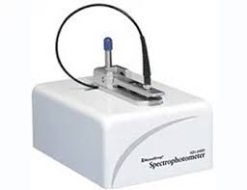
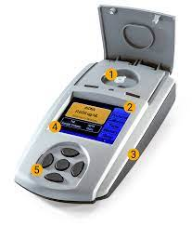
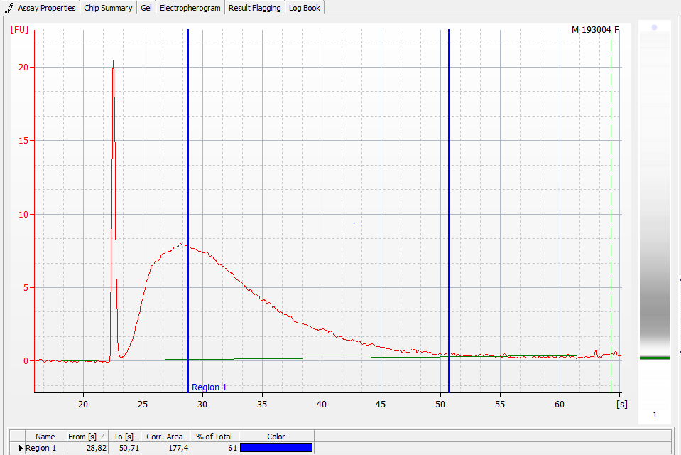
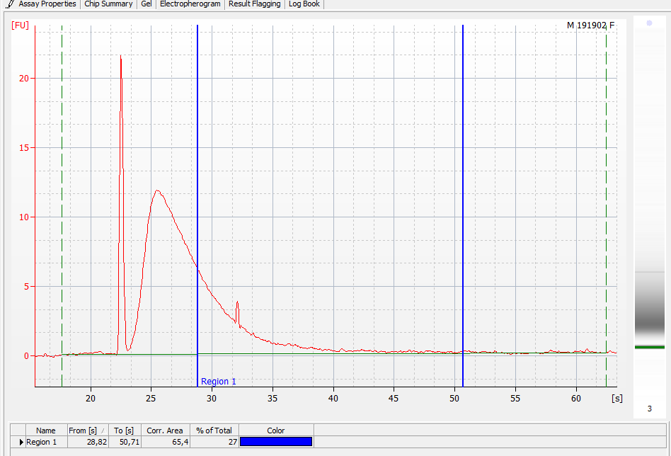
QUALITY OF RNA SAMPLES
Concentration of the analyte
Contaminants -UV absorbance
Fragmentation DV200 ≥30%
RNA demodified
DNA free
Quality | DV200 | Quantity
High | >70% | 20 ng
Medium | 50-70% | 20-50 ng
Low | 30-50% | 50-100 ng
Too degraded | <30% | Not Recommended

Slide 21
for RT-PCR
RT-qPCR
RNA quality
Ct within 40 cycles for target genes
Ct<35 cycles for HSK
Short amplicons (~ 80 bases)
Efficiency of RT-qPCR methods
Linear dynamic range
for ISH
HSK gene detection

Slide 22
STANDARDIZATION OF RNA ANALYSIS
Any method shall be based on the definition of
LOD and LOQ → Analytical Sensitivity
Analytical specificity → Probe based methods
Accuracy → Diagnostic accuracy (PPA, PNA)
Repeatability → Intra-assay variance → short term precision
Reproducibility → Inter-assay variance → long term precision

Slide 23
Reverse transcription (RT) is A critical step
# depends on the analyte (miRNA or mRNA)
# MMLV→ low processivity and errors
# the abundance of the analyte (Montecarlo Effect)
# the type of sample (FFPE, fresh frozen, liquid biopsy)
# different priming strategies and RT enzyme
RT REACTION HAS NOT 100% YIELD!!
AMV
Method | cDNA dilution in PCR mix
 |  | 1:10 | 1:40 | 1:160 | 1:640 | 1:2560 | 1:10240 | E%
6-MERS M-MLV | TS | 30.79 (0.01) | 32.65 (0.04) | 34.79 (0.33) | 37.89 (0.42) | - | - | 84
 | TP | 27.56 (0.04) | 29.22 (0.04) | 31.70 (0.05) | 33.63 (0.15) | 35.24 (0.35) | 37.67 (0.40) | 98
 | DPD | 28.97 (0.29) | 30.82 (0.12) | 32.71 (0.27) | 34.99 (0.43) | - | - | 100
 | ACTB | 20.43 (0.25) | 21.30 (0.16) | 23.20 (0.06) | 25.43 (0.14) | 27.76 (0.18) | 30.09 (0.22) | 100
15-MERS M-MLV | TS | 29.37 (0.21) | 30.61 (0.07) | 33.34 (0.01) | 35.98 (0.23) | - | - | 85
 | TP | 28.30 (0.16) | 29.54 (0.05) | 31.64 (0.08) | 33.38 (0.40) | 35.96 (0.45) | 38.02 (0.49) | 100
 | DPD | 29.24 (0.14) | 30.31 (0.14) | 32.49 (0.31) | 35.34 (0.48) | - | - | 97
 | ACTB | 20.60 (0.13) | 21.85 (0.17) | 23.74 (0.21) | 25.59 (0.11) | 27.76 (0.19) | 30.36 (0.20) | 100
Mix of specific AMV | TS | - | 29.88 (0.48) | 31.66 (0.04) | 34.17 (0.43) | 35.80 (0.45) | 38.60 (0.47) | 91
 | TP | - | 26.76 (0.05) | 28.86 (0.08) | 31.01 (0.30) | 33.45 (0.40) | 36.26 (0.40) | 80
 | DPD | - | 27.96 (0.08) | 30.54 (0.18) | 32.65 (0.28) | 35.28 (0.35) | 36.48 (0.48) | 86
 | ACTB | 18.44 (0.04) | 19.95 (0.14) | 21.84 (0.05) | 24.22 (0.23) | 26.42 (0.02) | 28.98 (0.11) | 92
MmLV
ACTB
Mix of specific
Random 6mers
Random 6mers
Random 15mers
Random 15mers
n.d. Mix of specific

Slide 24
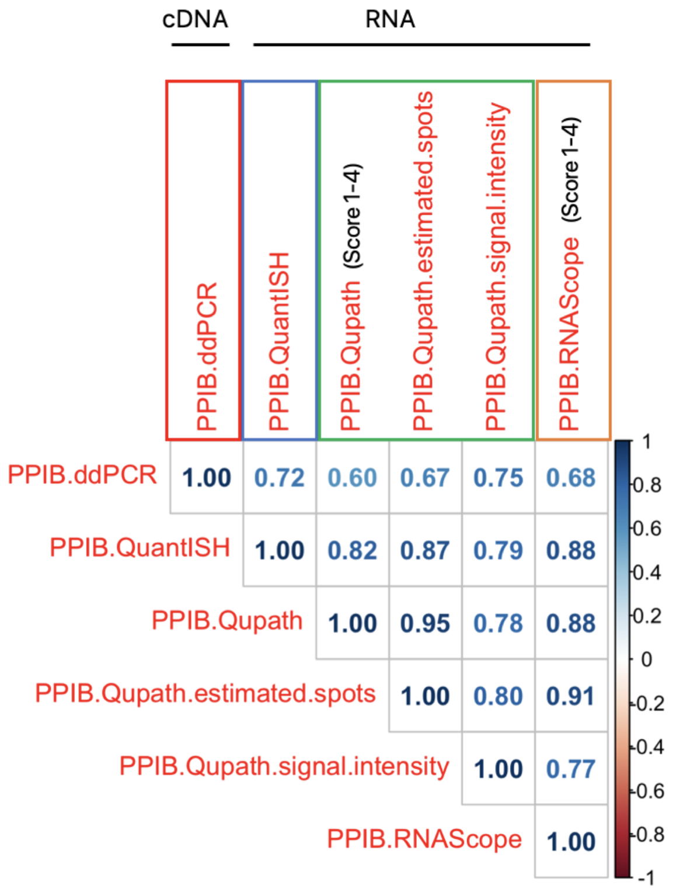
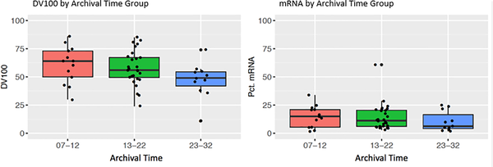
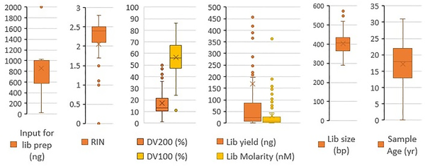
NORMALIZATION AND DATA ANALYSIS
AGE OF STORAGE
Zhao Y, Mehta PLOS ONE 14(5): e0216050. https://doi.org/10.1371/journal.pone.0216050
https://journals.plos.org/plosone/article?id=10.1371/journal.pone.0216050
# Proper normalization of data
# Dedicated bio-informatic tools for complex data analysis

Slide 25
CONCLUSIONS
# Follow strictly ISO standard and CEN technical documents for RNA in vitro diagnostics to standardize the entire analytical workflow – go to https://www.spidia.eu/projects/standard-documents to get an overview of the relevant standard documents
# RNA isolation procedures should be conform and optimized with the analytical test
# Any deviation from the ”conventional procedures” shall be reported, verified and validated
# RNA quality controls are mandatory before analytical tests to verify the conformity of the sample
# For RT based tests, reverse transcription reaction should be selected in agreement with specific RNA abundance and downstream analytical test
# Standardization of methods shall be based on dedicated experiments defining LOD, LOQ, accuracy, repeatability and reproducibility
# Participation to EQA/proficient tests

Slide 26
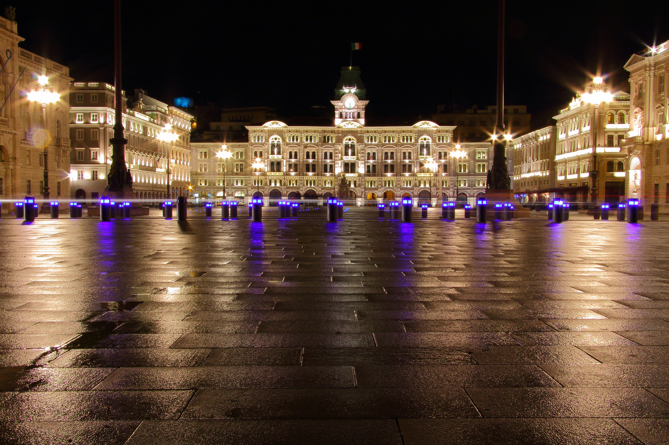

Thank you for you attention!!
Giorgio Stanta
Ermanno Nardon
Eleonora De Martino
Eros Azzalini
Caterina Medeot
Domenico Tierno
Iris Zalaudek
Claudio Conforti……
The SPIDIA project has received funding under the Seventh Research Framework Programme of the European Union, FP7-HEALTH-2007-1.2.5 under grant agreement no. 222916.
The SPIDIA4P project has received funding from the European Union´s Horizon 2020 research and innovation programme under grant agreement no. 733112.

Slide 27
Serena Bonin
Department of Medical Sciences
sbonin@units.it

