Slide 1

Rationale for defining standardized pre-analytical workflows in light of the requirements of the EU IVDR
Biomedical Research Training Workshop Week
Online, May 13th 2020
Dr. Uwe Oelmüller, SPIDIA4P Coordinator, QIAGEN GmbH
www.spidia.eu

Slide 2

New Technologies and Standards for Pre-analytical Workflows
SPIDIA – FP7 (2008 – 2013)
  16 Partners
  New technologies for sample collection, stabilization, processing, transport, storage (Blood, Tissues)
  9 EU CEN Standards
SPIDIA4P – H2020 (2017 – 2020)
  19 Partners
  14 associated consortia & stakeholder organizations
  13 additional new CEN & ISO Standards
  EQAs
  European implementation
  www.spidia.eu ⇨ New Website. Subscribe the Newsletter!
The SPIDIA project has received funding under the Seventh Research Framework Program of the European Union, FP7-HEALTH-2007-1.2.5, under grant agreement no. 222916. The SPIDIA4P project receives funding from the European Union’s Horizon 2020 research and innovation programme under grant agreement no. 733112.

Slide 3


Deficiencies in Routine Healthcare and Research demand for Improvements
Diagnostic errors cause about 10% of all patient deaths and about 17% of adverse events
Institute of Medicine (IOM) Report Sept. 2015
Pre-analytical phase accounts for 46% to 68% of clinical laboratory errors
Medical Laboratory Observer, May 2014
Unnecessary expenditure caused by pre-analytical errors in a typical U.S. hospital (~ 650 beds) of ~ $1.2 million per year
Green SF. Clin Biochem. 2013
Irreproducible preclinical research exceeds 50%, US $28B / year spent on preclinical research that is not reproducible - in the US
Freedman LP, Cockburn IM, Simcoe TS (2015) PLoS Biol 13(6): e1002165.doi:10.1371/journal.pbio.1002165

Slide 4
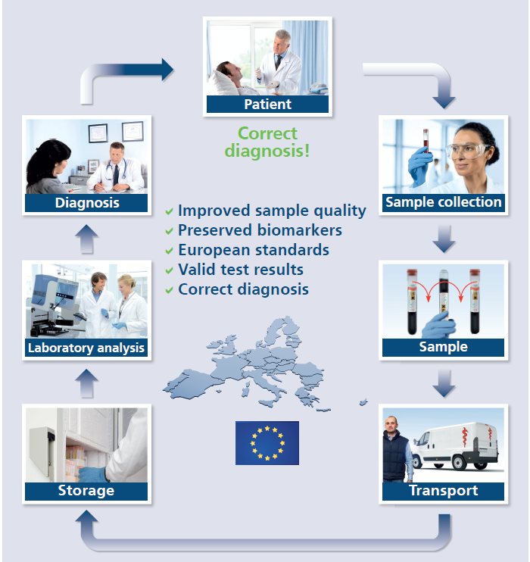



An Analytical Test Result is the Result of an Entire Workflow
Specifying, developing and verifying preanalytical workflows has to be part of the analytical test development
European Conference. Standards: Your Innovation Bridge. Brussels (2014). SPIDIA Booth.

Slide 5
Changes of Blood Cellular RNA Profile: 48 Hours After Collection
Up-regulated FOSB mRNA level
Down-regulated TNFRS mRNA level
Stabilized RT *
EDTA 2-8 °C
EDTA RT
Stabilized RT *
EDTA 2-8 °C
EDTA RT
* PAXgene Blood RNA
Malentacchi F et al. (2014). SPIDIA-RNA: Second External Quality Assessment for the Pre-Analytical Phase of Blood Samples Used for RNA Based Analyses. PLoS ONE 9(11): e112293.
Zhan H et al. (2014). Biomarkers for Monitoring Pre-Analytical Quality Variation of mRNA in Blood Samples. . PLoS ONE 9(11): e111644.

Slide 6
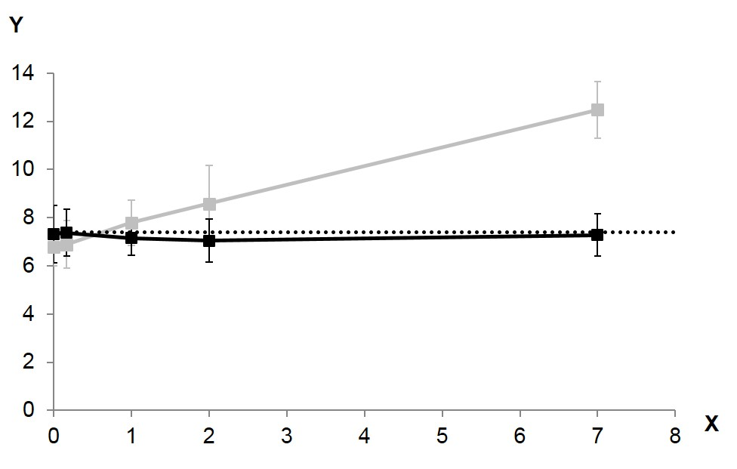
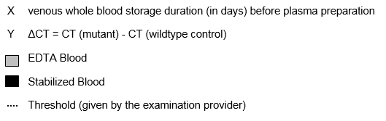
Post Blood Collection ccfDNA Profile Changes - Impact on EGFR Test
Spiked restriction enzyme treated EGFR DNA with mutation T790M, equivalent to 200 copies
ccfDNA tested with the commercially available EGFR Plasma PCR Kit (RUO)
Source: ISO 20186-3:2019
Molecular in vitro diagnostic examinations — Specifications for pre- examination processes for venous whole blood — Part 3: Isolated circulating cell free DNA from plasma. Annex A.
The average of 8 donors is shown

Slide 7
Major Efforts for Improvements
Technologies
International ISO & CEN Standards
External Quality Assessment (EQA) Schemes

Slide 8
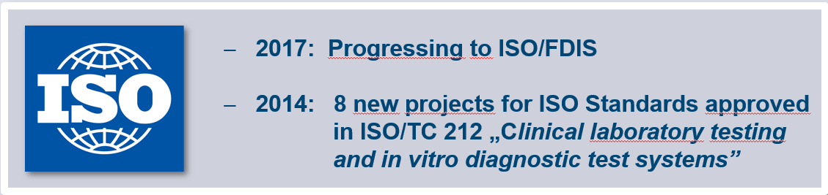

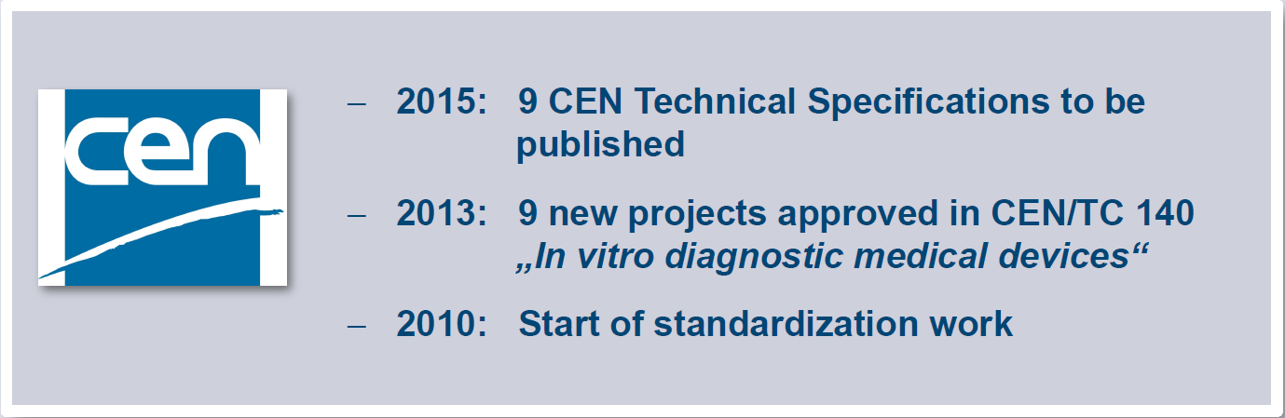
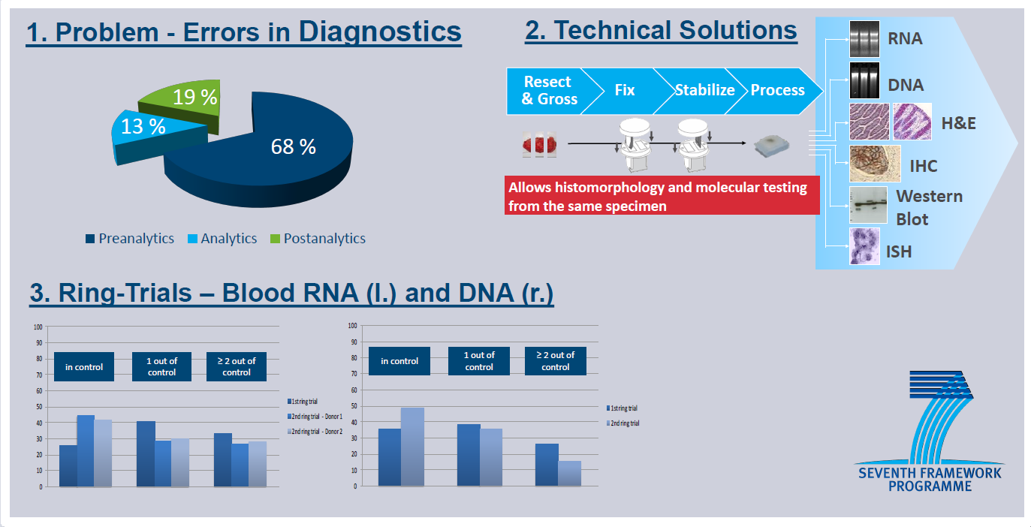

SPIDIA’s Road to Standardization
2019
8 ISO/International Standards
Vienna Agreement 1991
European Conference. Standards: Your Innovation Bridge. Brussels (2014). SPIDIA Booth.

Slide 9

Highly Consensus Driven Process for Developing Standards
CEN
Recognized by the EU and the European Free Trade Association (EFTA) as being responsible for developing standards at European level
Development of a European Standard (EN) or International Standard (ISO) is governed by the principles of consensus, openness, transparency, national commitment and technical coherence
One European Standard replaces 34 national standards
CEN/TC 140 (Committee for in vitro diagnostic medical devices)
      34 EU countries National Standards Bodies (NSB)
      Stakeholders in liaison & cooperations
      European Commission (EC), ESP (European Society of Pathology), EFLM (European Federation of Laboratory Medicine), IFCC (Int. Federation of Clinical Chemistry and Laboratory Medicine), JISC (Japanese Industrial Standards Committee), MedTech Europe (Alliance of European medical technology industry associations), EPBS (European Association for Professions in Biomedical Science), BBMRI-ERIC (Biobanking and BioMolecular resources Research Infrastructure - European Research Infrastructure Consortium), ISO/TC 212 (Clinical laboratory testing and in vitro diagnostic test systems), ISO/TC 276 Biotechnology

Slide 10
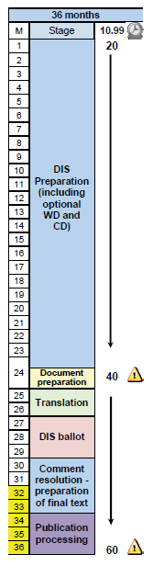
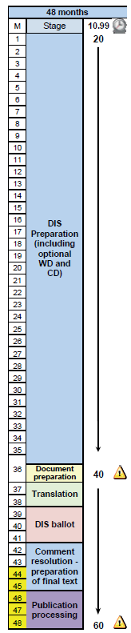

ISO/IS Development – Usually a 36 to 48 Months Period
ISO/TC 212
Technical Committee for Clinical Laboratory Testing and in vitro Diagnostic Test Systems
41 member countries, 22 observing members
Source: https://www.iso.org/files/live/sites/isoorg/files/developing_standards/docs/en/Target_date_planner_4_ISO_standards_development_tracks_2017.pdf

Slide 11
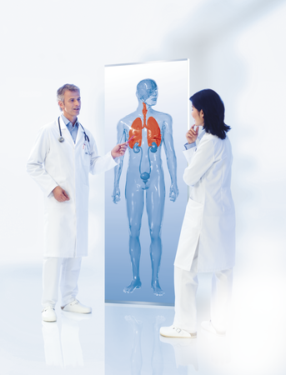

CEN - Twofold Role of Standardization
Traditional Role of Standards
  Source of technical know-how
  Trade facilitation and opening of markets
  Providing a scientific basis for legislation in the health, safety and environment sectors
Valued-added role for research and innovation
  Speeding up innovation by providing the requisite knowledge base
  (technology transfer)
  New ideas, technologies and products benefit from standardization to get into the marketplace and to be successful
Source: Gindele 2013
http://www.iso.org/iso/home/about/conformity-assessment.htm

Slide 12
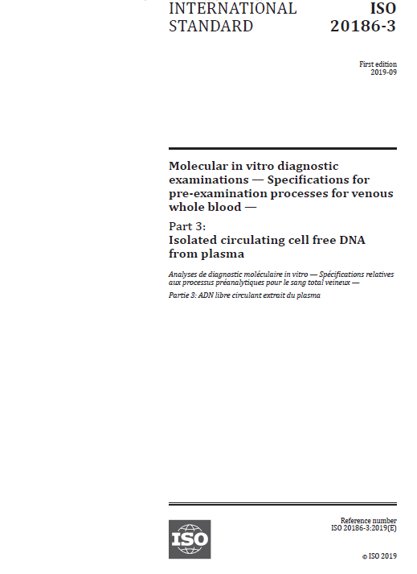

22 CEN & ISO Standard Documents and EQAs by 2021
Molecular in-vitro diagnostic examinations - Specifications for pre-examination processes for
  Blood — Cellular RNA, gDNA, ccfDNA, ccfRNA
  Blood – Exosomes, ccfRNA
  Blood Tumor Cells – DNA, RNA, staining
  Tissue (FFPE) — DNA, RNA, Proteins
  Tissue (Frozen) – RNA, Proteins, DNA
  Tissue (FFPE) - staining
  Fine Needle Aspirates – DNA, RNA, Proteins
  Saliva – DNA
  Urine & Body Fluids – cfDNA
  Metabolomics – Urine, Serum, Plasma
  Microbiome – Stool, Saliva etc.
published CEN published ISO in development

Slide 13
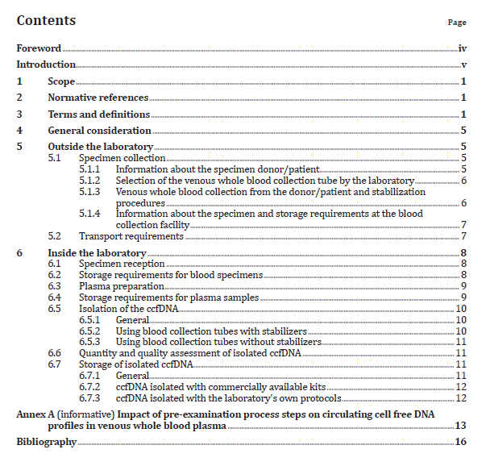
ISO 20186-3 – Pre-examination Processes for Blood ccfDNA
ISO 20186-3:2019 - Molecular in vitro diagnostic examinations — Specifications for pre-examination processes for venous whole blood — Part 3: Isolated circulating cell free DNA from plasma

Slide 14
Pre-analytical Workflow - Same Standards for all Segments
Biobanks
  Source for good quality samples ⇨ required for biomarker & analytical test development
Biomedical & Translational Research
  Academia
  Pharma industry
  Diagnostic Industry
Diagnostics
  High sample quality is the safe way
  Analytical assay might tolerate lower quality or not  Verification studies

Slide 15
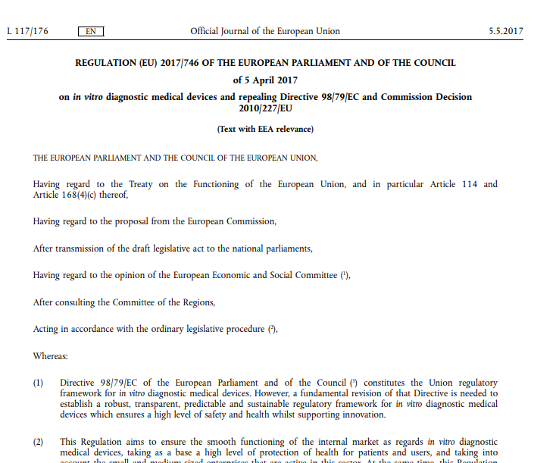
New EU In Vitro Diagnostic Medical Device Regulation (IVDR)
entered into force on 26 May 2017
will replace the EU’s current Directive on in vitro diagnostic medical devices (98/79/EC)
transition period until 26 May 2022

Slide 16
New IVDR – Key Changes
Risk Classes
  from list-based approach to risk-based approach
  four risk categories: A (low risk) to D (high risk)
Performance Evaluation
  process of performance evaluation defined
  required throughout the lifetime of the device
Clinical Evidence
  scientific validity, analytical performance, and clinical performance
Post Market
  post market performance follow-up
  incident reporting and trending
Conformity Assessment Routes
  reflect the new classification rules
  introduction of pre-examination process parameters
  more need to use a Notified Body
Scrutiny and Traceability
  new requirements in technical documentation
  unique Device Identifier (UDI)
Source: https://www.bsigroup.com

Slide 17
New In Vitro Diagnostic Regulations 2017 (IVDR)
New European In Vitro Diagnostic Regulation in force since May 2017
Pre-analytical workflow parameters in several sections
  6. PRODUCT VERIFICATION AND VALIDATION (Annex II)
  6.1. Information on analytical performance of the device
  6.1.1. Specimen type
      This Section shall describe the different specimen types that can be analysed, including their stability such as storage, where applicable specimen transport conditions and, with a view to time-critical analysis methods, information on the timeframe between taking the specimen and its analysis and storage conditions such as duration, temperature limits and freeze/thaw cycles

Slide 18
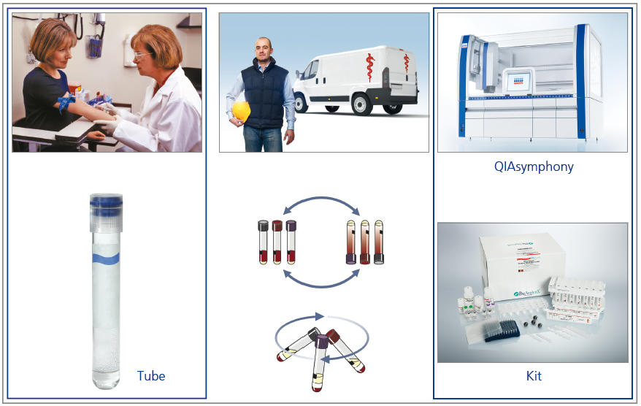


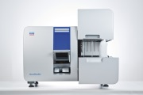

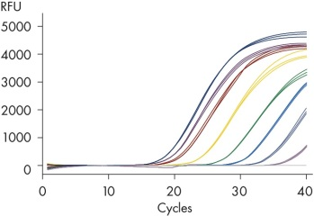
Pre-analytical Steps: Part of a Whole Diagnostic Test Workflow
Storage Transport
Collection
& Stabilization
Sample Processing
Analyte
Isolation
Analytical Test
Data
Analysis

Slide 19
Laboratory Developed Tests in the IVDR
Main Text
(29) Health institutions should have the possibility of manufacturing, modifying and using devices in-house and thereby addressing, on a non-industrial scale, the specific needs of target patient groups which cannot be met at the appropriate level of performance by an equivalent device available on the market.
Article 5
A device may be placed on the market or put into service only if it complies with this Regulation when duly supplied and properly installed, maintained and used in accordance with its intended purpose.
. . . .
. . . .
Devices that are manufactured and used within health institutions, with the exception of devices for performance studies, shall be considered as having been put into service.
With the exception of the relevant general safety and performance requirements set out in Annex I (GENERAL SAFETY AND PERFORMANCE REQUIREMENTS), the requirements of this Regulation shall not apply to devices manufactured and used only within health institutions established in the Union, provided that all of the following conditions are met:
    various conditions . . . incl. ISO 15189 accreditation or national provisions where applicable . . . .

Slide 20
Annex I
Chapter II
9. Performance characteristics
9.1. Devices shall be designed and manufactured in such a way that they are suitable for the purposes referred to in point (2) of Article 2, as specified by the manufacturer, and suitable with regard to the performance they are intended to achieve, taking account of the generally acknowledged state of the art. They shall achieve the performances, as stated by the manufacturer and in particular, where applicable:
  the analytical performance, such as, analytical sensitivity, analytical specificity, trueness (bias), precision (repeatability and reproducibility), accuracy (resulting from trueness and precision), limits of detection and quantitation, measuring range, linearity, cut-off, including determination of appropriate criteria for specimen collection and handling and control of known relevant endogenous and exogenous interference, cross- reactions; and . . . .
  the clinical performance . . . . . .
Chapter III
20.4.1. The instructions for use shall contain all of the following particulars:
(q) conditions for collection, handling, and preparation of the specimen;

Slide 21
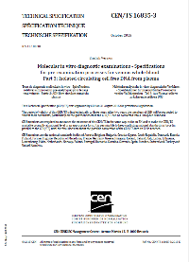

Role of Standards and Technologies
New EU IVDR – in-vitro Diagnostic Device Regulation 2017
Pre-analytical workflow parameters
EN ISO & CEN Standards
SOPs
Technologies & Products

Slide 22
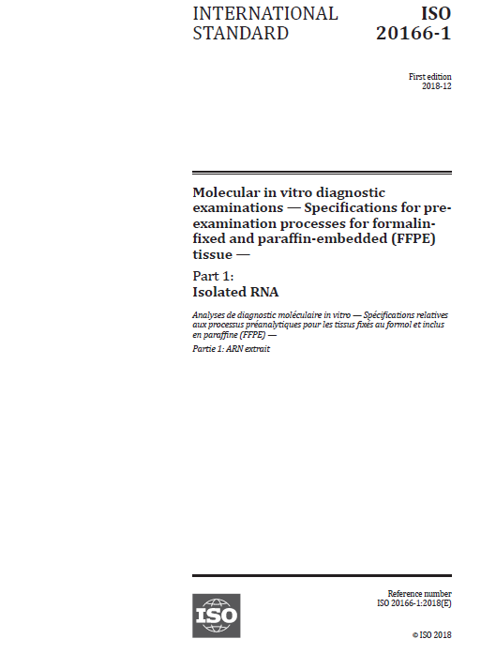
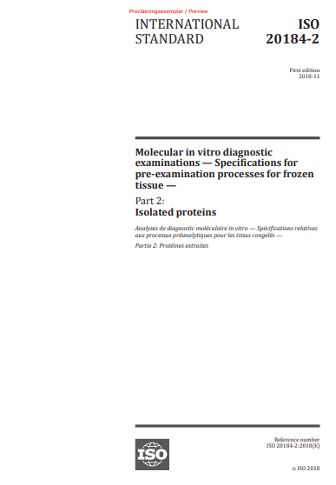
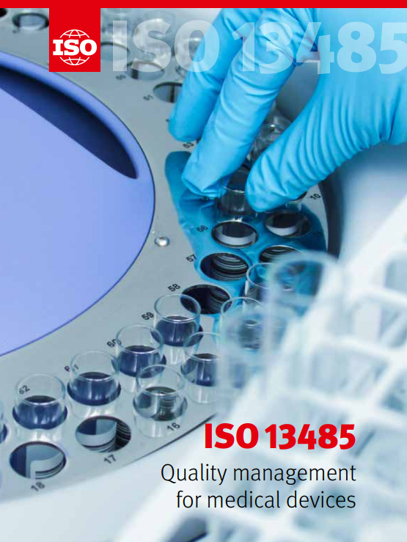
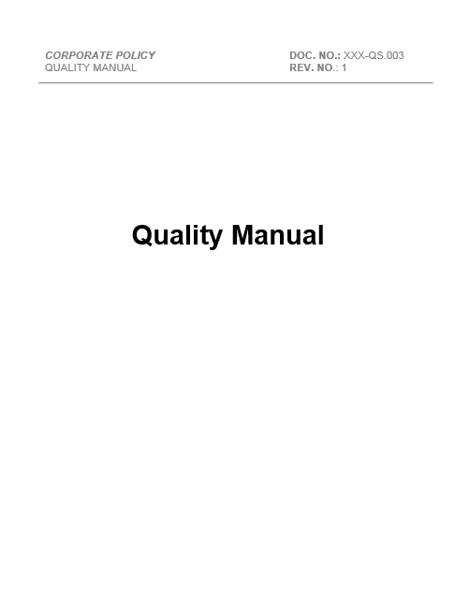
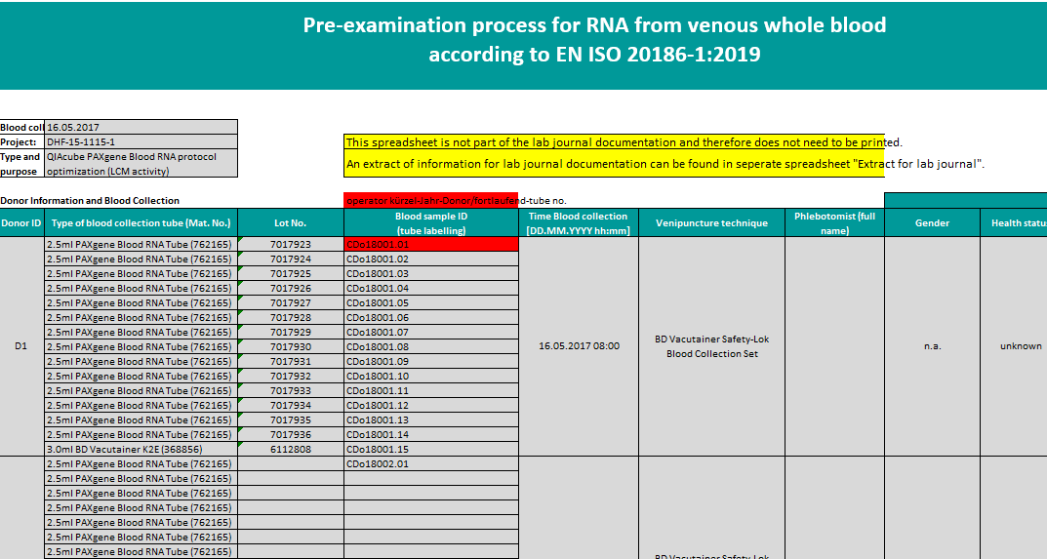
Implementation of Preanalytical Standards
  Example: SPIDIA4P partner PreAnalytiX (QIAGEN/BD Company)
Product Development Process
Certification according to ISO 13485
Company Quality Manual: Process Landscape
Global Process SOPs incl. legal requirements
Technical SOPs for pre-analytical workflows based on ISO & CEN standards

Slide 23
ISO and CEN Standards can always be used
  New ideas, technologies and products benefit from standardization to get into the marketplace and to be successful
    Build customer confidence that your products are safe and reliable
    Meet regulation requirements, at a lower cost
    Reduce costs across all aspects of your business
    Gain market access across the world
  International Standards help businesses of any size and sector reduce costs, increase productivity and access new markets
  “Standards make market access easier, in particular for SMEs. They can enhance brand recognition and give customers the guarantee that the technology is tested and reliable”
  Jens Albens CEO, Nanotron Technologies Ltd, Germany

Slide 24


German SWR TV – Substantially Varying Test Results between Laboratories
https://www.swr.de/wissen/odysso/Blut-Untersuchung-Missstand-bei-Bluttests,aexavarticle-swr-77780.html
SWR - Juni 2019

Slide 25


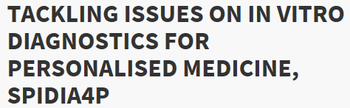
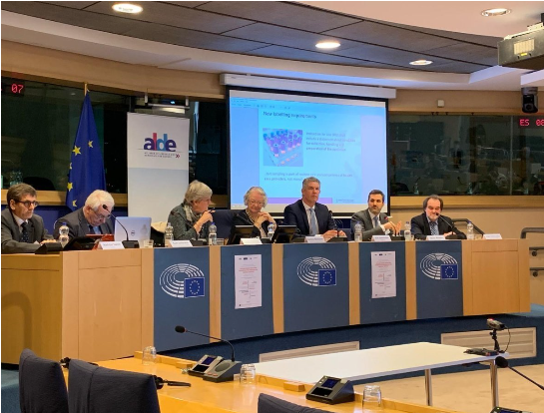
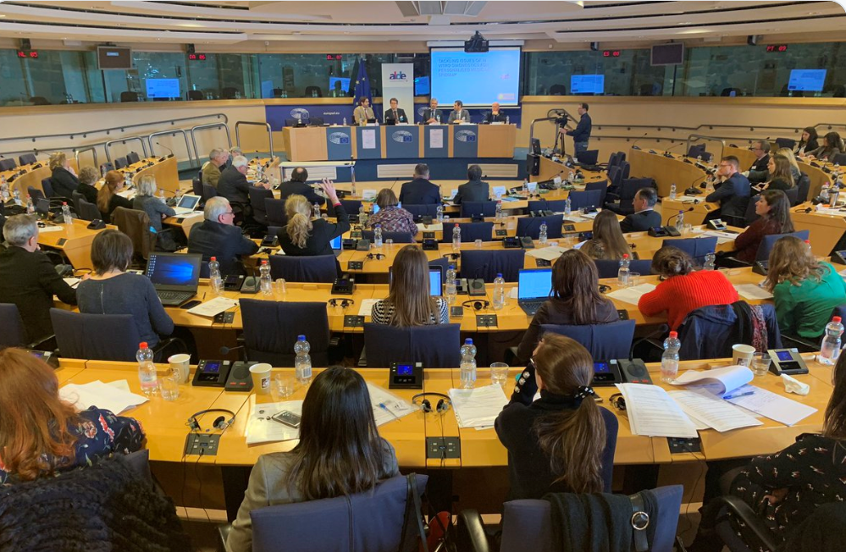
EU Parliament Event on March 5th 2019

Slide 26
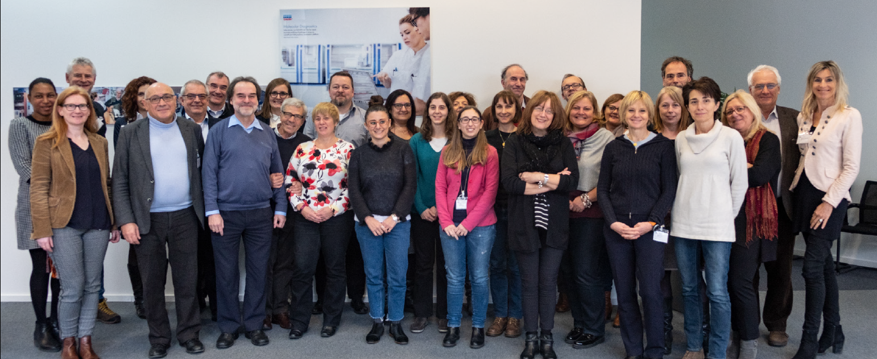

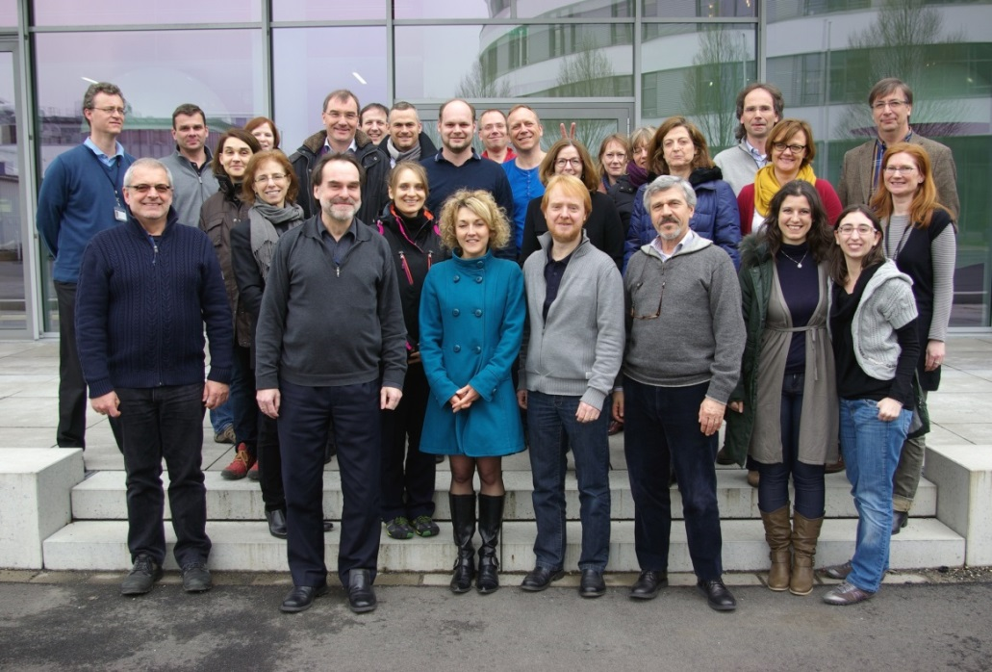
A big Thank You goes to . . .
. . . to the SPIDIA & SPIDIA4P Consortium Members, CEN/TC 140, ISO/TC 212 and all European and International Partners!
www.spidia.eu - New Website

Slide 27
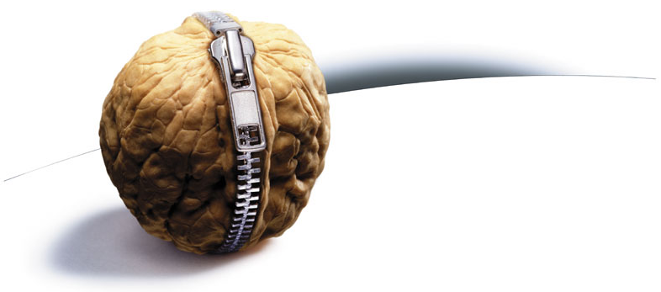
Thank you!
Questions ?

